Slide 1
Mathematical theory of population genetics
Fall 2012
Department of mathematics and statistics
University of Helsinki
LECTURE II

Slide 2
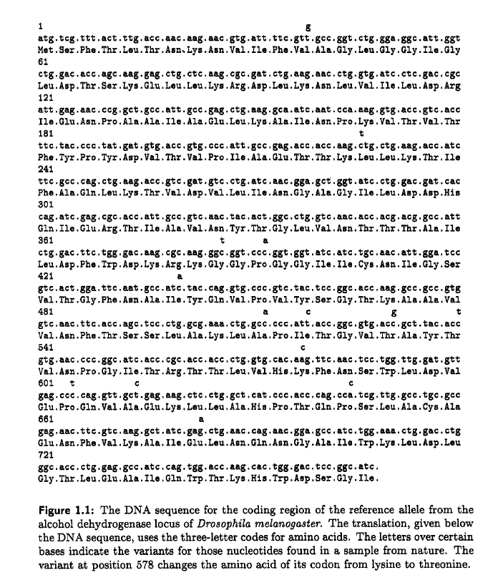
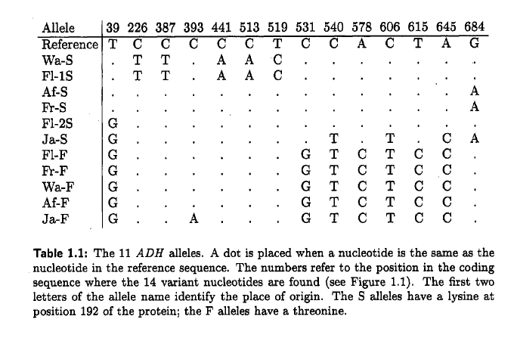
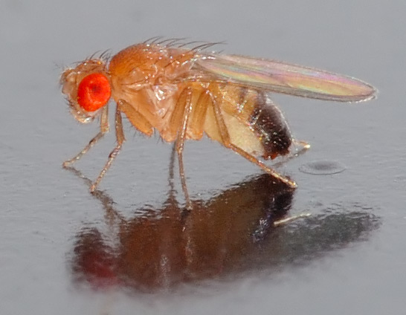
KREITMAN, M. 1983. Nucleotide polymorphism at the alcohol dehydrogenase locus of Drosophila melanogaiter.. Nature 304: 412-417

Slide 3
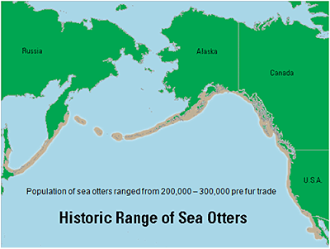
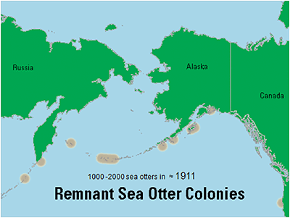
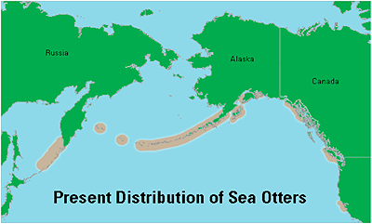
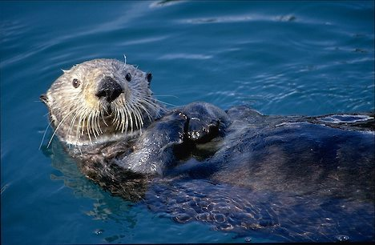
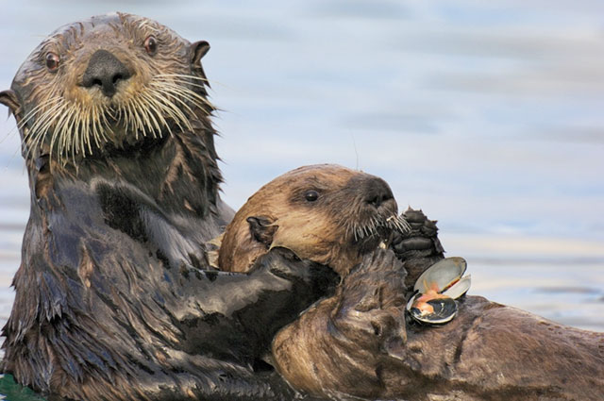
Lidicker, W.z., F.C. Mccollum, 1997. Allozymic variation in california sea otters. Journal of mammalogy 78: 417-425.

Slide 4
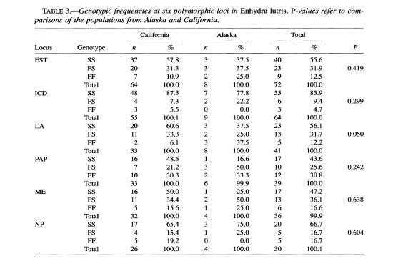
Lidicker, W.z., F.C. Mccollum, 1997. Allozymic variation in california sea otters. Journal of mammalogy 78: 417-425.

Slide 5
What is the mating scheme in the otter population?

Slide 6
Hardy-weinberg equilibrium

Slide 7
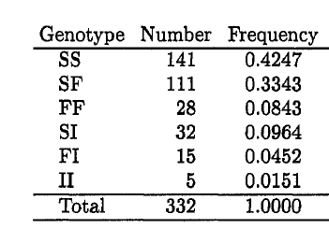

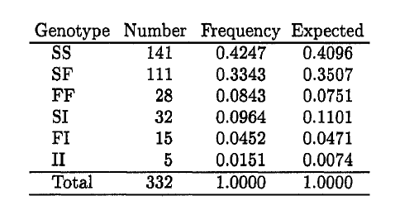
HARRIS, H. .1966. Enzyme polymorphisms in man. Proc. Roy. Soc. Ser.
B 164:298-310.

